Slide 1
Reports Section

Slide 2
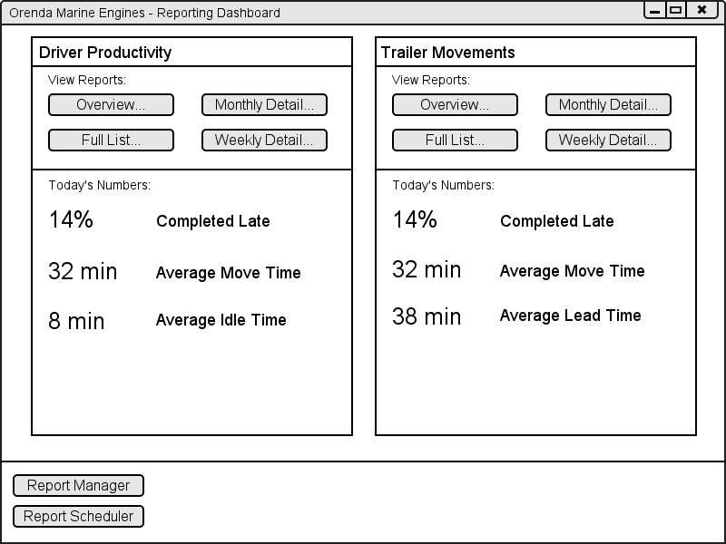
Executive Dashboard

Slide 3
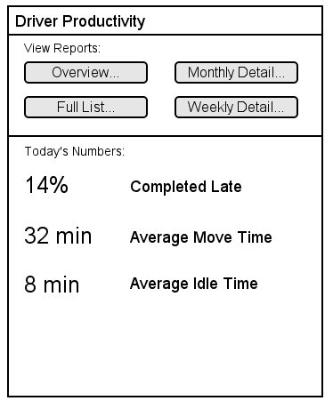
Report Panel Concept
Access to all reports related to a category.
Broad daily statistics.
Fully configurable.

Slide 4
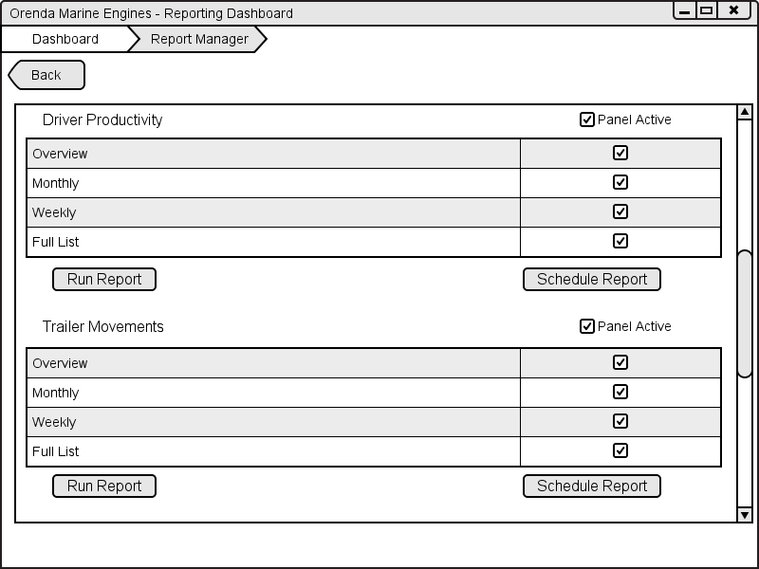
Report Manager

Slide 5
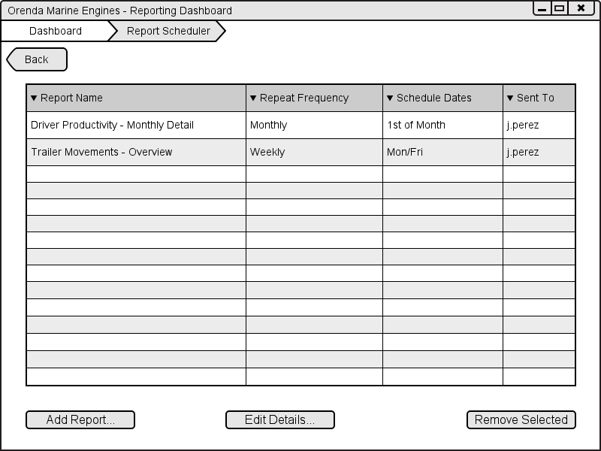
Scheduling

Slide 6
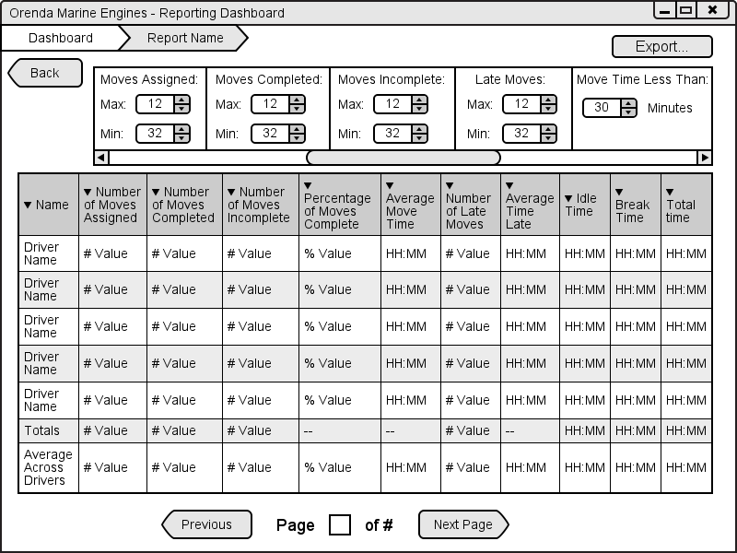
Report View

Slide 7
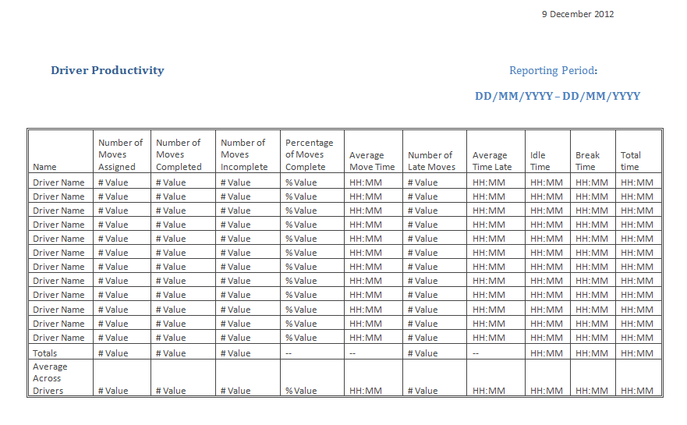

Slide 8
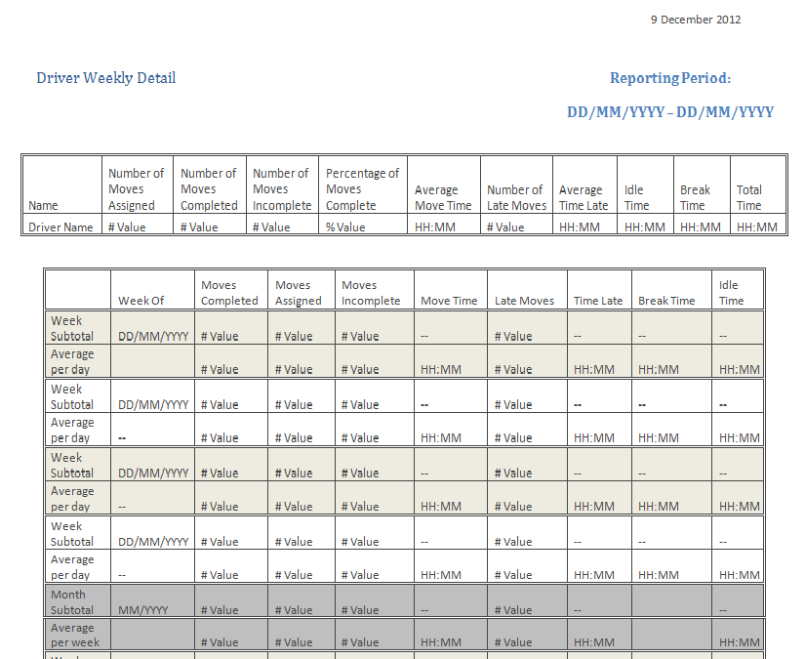

Slide 9
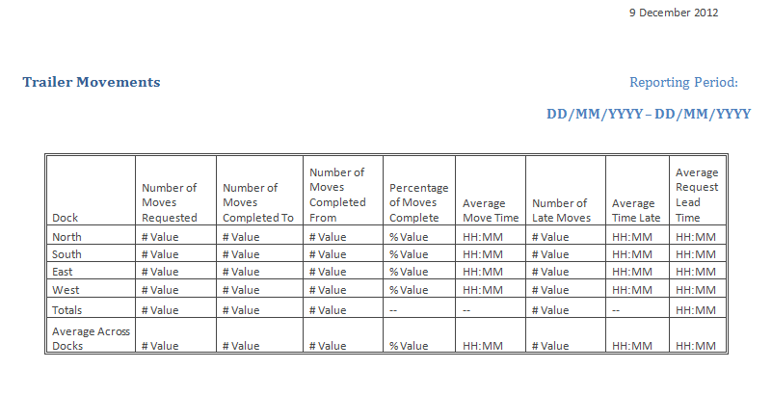

Slide 10
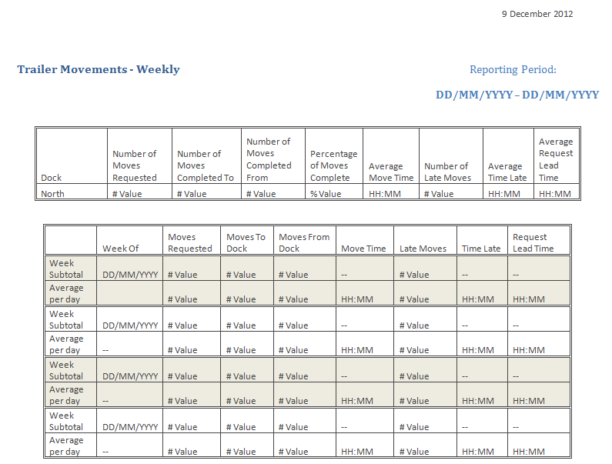

Slide 11
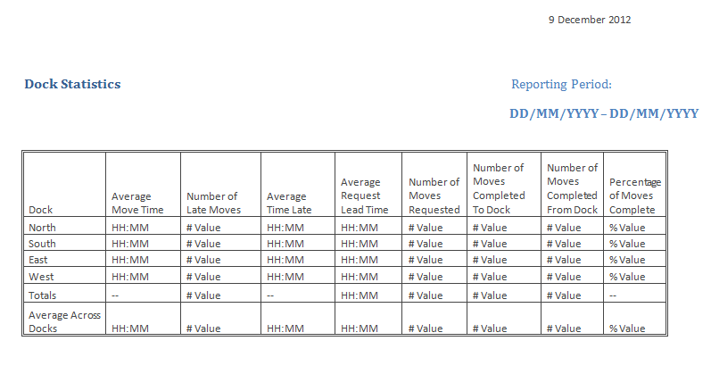

Slide 12
Implementation Section

Slide 13
Development and Quality Assurance
Agile development methodology
Working sections of the system
As frequent as weekly updates

Slide 14
Development and Quality Assurance

